Slide 1

Recognition of emotional speech using MFCC and Machine Learning Technique
DEPARTMENT OF COMPUTER SCIENCE AND ENGINEERING
SESHADRI RAO GUDLAVALLERU ENGINEERING COLLEGE ,GUDLAVALLERU
Under the Guidance of
Mrs. K. Nandini, MTech(Ph.D.)
Thummalacharla Divya (20481A05N3)
Shaik Subhani (20481A05L6)
Surapaneni Mounika (20481A05M2)
Tummala Vamsi Nandhan (20481A05N5)

Slide 2
CONTENTS
Abstract
Objectives
Related work
Methodology
Implementation

Slide 3
ABSTRACT
Speech to text conversion and identifying the emotion of a person through speech is a critical task in human-computer interaction, that require understanding and responding to human emotions. MFCCs are widely used for finding various parameters like pitch, intensity, loudness etc. Our approach involves extracting vectors from speech utterances and using them as input to a machine learning model.
We focus on classifying mainly 8 emotions into a set of predefined categories such as happiness, sadness, anger, and neutral. The extracted vectors are used to capture spectral features, which are then used to train a classification model, such as a Support Vector Machine (SVM) or Artificial neural network(ANN).We compare the performance of the MFCC-based approach with other feature extraction methods and evaluate the accuracy, precision, recall, and F1-score of our model.

Slide 4
OBJECTIVES
Human-Computer Interaction (HCI): Speech emotion recognition enhances user experiences in interactive systems by allowing computers to recognize and respond to the emotional states of users. This is applied in virtual assistants, chatbots, and other HCI systems to create more natural and personalized interactions.
Healthcare and Well-being: Speech emotion recognition has potential applications in healthcare for assessing the emotional well-being of individuals. It can be used in mental health monitoring, stress detection, and as a tool for emotional support in telemedicine applications.
Market Research: Companies utilize speech emotion recognition in market research to analyze consumer responses to advertisements, products, or services. By understanding the emotional reactions expressed in focus groups or survey responses, businesses can make informed decisions about their marketing strategies.

Slide 5
RELATED WORK
Our method consists of a carefully constructed pipeline that is designed to identify distinct emotional states accurately by extracting features from speech signals.
We start by collecting a large dataset of emotional speech recordings that spans a variety of situations and emotions
Preprocessing is the process of carefully cleaning and dividing the audio data in order to enhance the input features' quality.
We perform extensive evaluations on a validation set for parameter tuning as well as a different testing set for objective performance assessment to guarantee robust performance.
Through metrics like recall, accuracy, precision, and F1 score, Our approach enables a more thorough analysis of the model's performance and provides insight into how well it can distinguish between different emotional expressions.

Slide 6
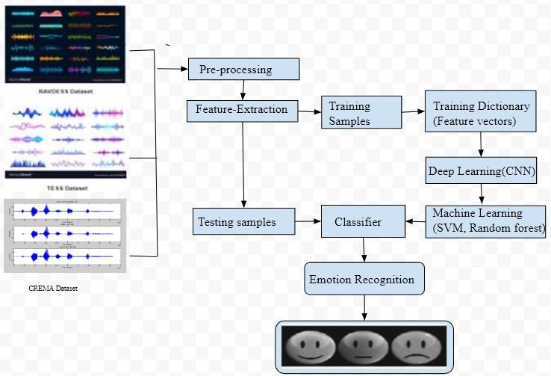
METHODOLOGY

Slide 7
IMPLEMENTATION
Pre-processing:
Gathering of Data
Removal of Noise
Segmentation
Normalization
Windowing

Slide 8
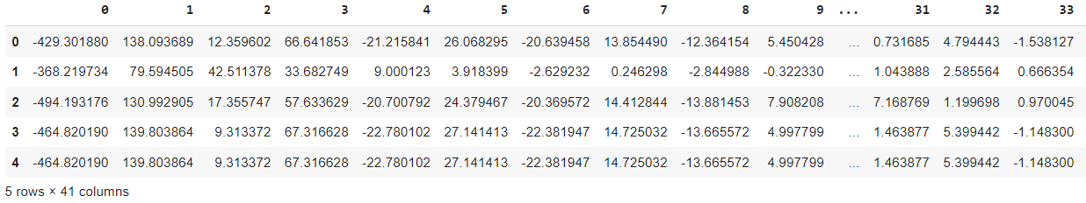
FEATURE EXTRACTION
The speech signal contains a large number of parameters that reflect the emotional characteristics.
Extract the features from audio file. These feature vectors are used to train the machine learning models.

Slide 9
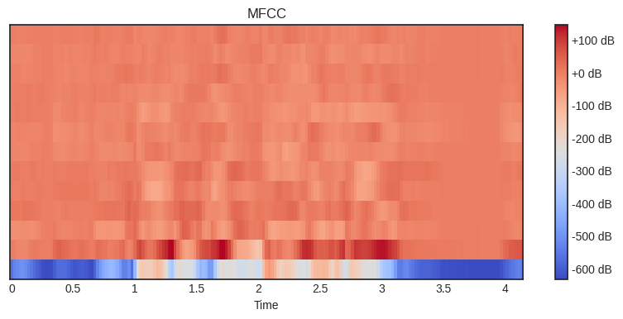
HEAT MAP
A heatmap uses a color gradient to graphically depict the intensity of a variable, in this case, the MFCC coefficients. Usually, the y-axis shows the individual MFCC coefficients, and the x-axis shows the time or frames.
The heatmap can be used to visualize consistent patterns in the MFCC coefficients that may be related to specific emotions.

Slide 10
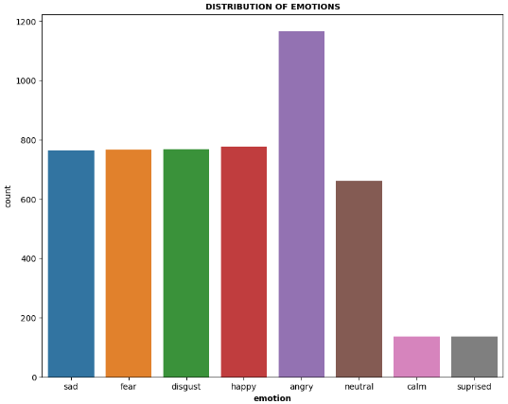
FEATURE SELECTION
Feature selection primarily consists of features that extract the essence of the provided audio, such as the Mel Spectrogram and MFCC
Spectrograms that visualize Mel Spectrograms are sounds that are recorded on the Mel scale as opposed to the frequency domain.
The frequency of a signal must be transformed logarithmically to create the Mel Scale.

Slide 11
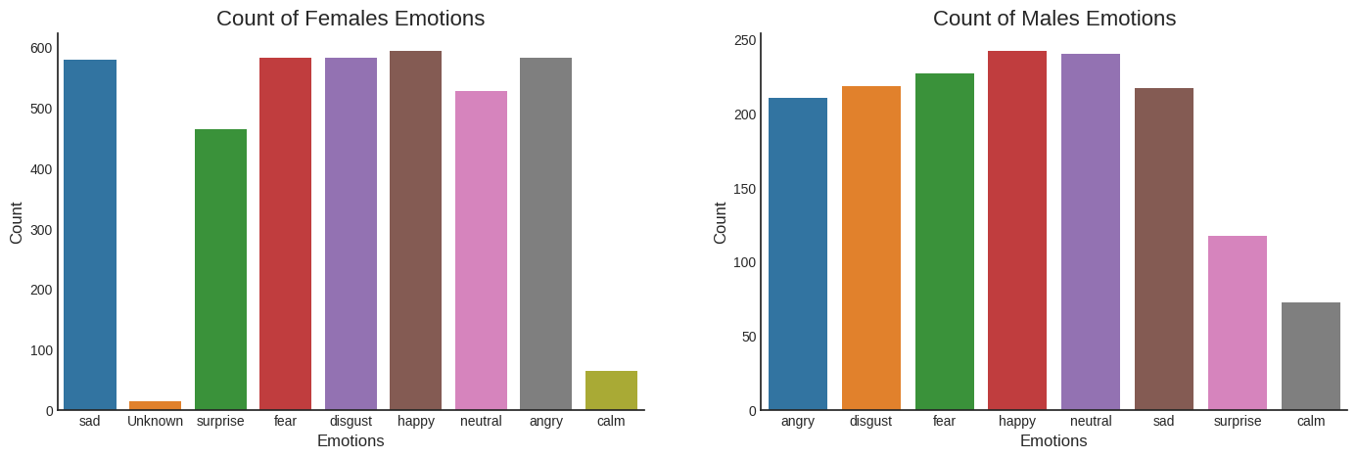

Slide 12
CONVOLUTIONAL NEURAL NETWORK
Speech data from the training set is used to train a convolutional neural network (CNN).
The accuracy of the training set is over 99% and the accuracy of the verification set is over 87% after 200 iterations.
The CNN model developed in this work has higher accuracy in both the training and verification sets when compared to SVM and MLP.

Slide 13
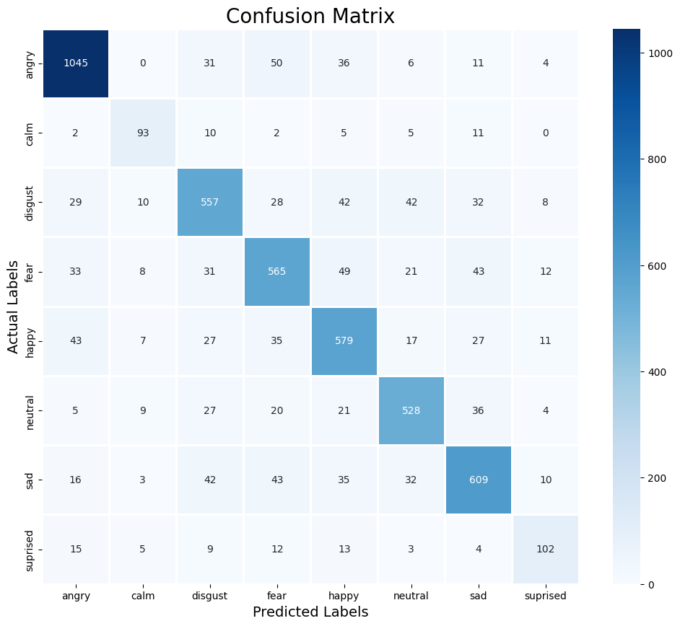

Slide 14
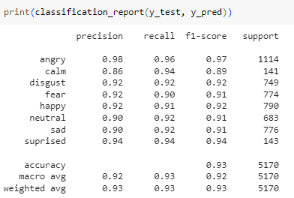

Slide 15
SUPPORT VECTOR MACHINE
SVM operates by finding an optimal hyperplane that separates different emotion classes in a high-dimensional feature space.
It is trained on labeled datasets, learning to differentiate between various emotional states during the training phase.
The data points that are closest to the decision boundary (hyperplane) are known as support vectors. These points are essential for defining the margin and choosing the best hyperplane.

Slide 16
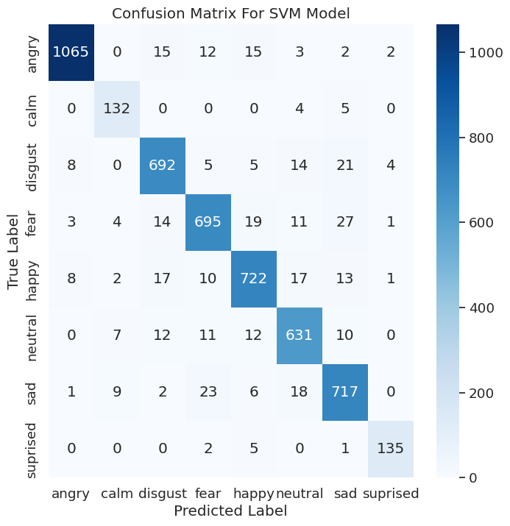

Slide 17
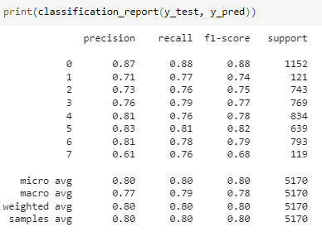

Slide 18
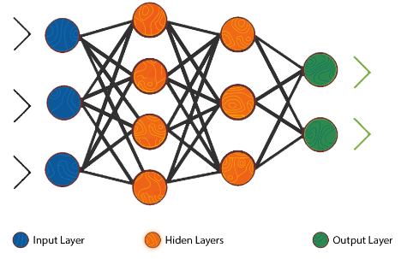
MLP CLASSIFIER
In Speech emotion recognition, MLP classifiers are used to identify and categorize spoken language emotions. Sentiment analysis, affective computing, human-computer interaction, and other fields can all benefit from the model's ability to grasp the intricate connections between emotional states and acoustic characteristics.
The accuracy of the training set used in the task of classification get 0.99% and test score get an accuracy value of 0.87%.

Slide 19
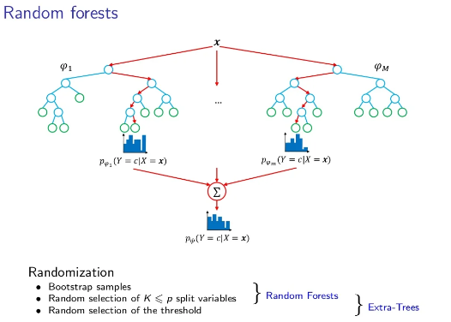
RANDOM FOREST
The Random Forest algorithm offers valuable insights into the features that are most important for accurately classifying emotions.
It is well known that Random Forests can manage noisy data and reduce overfitting, which is a common problem with machine learning models.
The random forest algorithm has an 89% accuracy rate.

Slide 20
CONCLUSION
Utilizing CNNs for sequence coding transformation and spatial feature representation allowed us to achieve a 93% accuracy on the RAVDESS dataset's holdout test set.
The results analysis leads to the consideration of using semantics in conjunction with speech to text conversion for the purpose of identifying emotions. With an overall emotion detection accuracy of 80%, the SVM model outperforms the CNN methods by almost 13%.
When speech features are combined with speech transcriptions, better outcomes are seen. The class accuracy for the Random Forest model is 89%, and the class accuracy for the MLPclassifier model is 87%.

Slide 21
PAPER INFORMATION
We have completed paper work.
We were published paper in the IEEE conference.
Conference Homepage: https://icesic.com/

Slide 22
REFERENCES
1)Preethi Jeevan, Professor, Department of Computer Science and Engineering, SNIST, Hyderabad-501301, India, Speech Emotion Recognition Using Machine Learning (IRJET), 2023.
2) Gupta, A., Morye, S., Sitap, M., & Chaudhary, S. (2021). Speech based Emotion Recognition using Machine Learning. Network, 6, 77-1.
3)Hazra, S. K., Ema, R. R., Galib, S. M., Kabir, S., & Adnan, N. (2022). Emotion recognition of human speech using deep learning method and MFCC features. Radioelectronic and Computer Systems, (4), 161-172.
4)Madanian, S., Chen, T., Adeleye, O., Templeton, J. M., Poellabauer, C., Parry, D., & Schneider, S. L. (2023). Speech emotion recognition using machine learning—A systematic review. Intelligent systems with applications, 200266.

Slide 23
5)Koti, V. M., Murthy, K., Suganya, M., Sarma, M. S., Kumar, G. V. S., & Balamurugan, N. (2024). Speech Emotion Recognition using Extreme Machine Learning. EAI Endorsed Transactions on Internet of Things, 10.
6)Surabhi V, Saurabh M. Speech emotion recognition: A review. International Research Journal of Engineering and Technology (IRJET). 2016;03:313-316 .
7)Mohan, M., Dhanalakshmi, P., & Kumar, R. S. (2023). Speech emotion classification using ensemble models with MFCC. Procedia Computer Science, 218, 1857-1868.

Slide 24
Thank you

